Slide 1
Coping with the emotional impact of cancer
Dr Rachael McCarthy
Macmillan Clinical Psychologist

Slide 2
Aims of this presentation
To explore the psychological impact of having a cancer diagnosis and common reactions and responses
To provide you with some psychological tools for coping
To provide you with a list of resources you can access beyond the webinar

Slide 3
Notes:
When you are diagnosed with cancer, it can feel like life is suddenly taking a different course; the life you were expecting to live and all the milestones that go with it, can suddenly feel uncertain; like the rug has been pulled from under your feet. Having uncertainty sprung upon us can mean all sorts of difficult thoughts and feelings and experiences show up, that add to our feeling of being out of control.
It can also feel very isolating, especially if you don’t know anyone else who has had cancer.

Slide 4
Emotional rollercoaster
Notes:
Receiving a diagnosis of cancer can feel like getting on an emotional rollercoaster – people often feel they are no longer in control of their lives or their destinies. Emotions they have not experienced before can show up and this can feel alarming and overwhelming. Family members and friends may also be on a rollercoaster. There is a lot to navigate and manage on top of the physical aspects of cancer and all the practicalities such as appointments/phone calls, time off work, child care, other commitments…it can feel like a huge juggle. You are not alone if you are feeling like this.

Slide 5
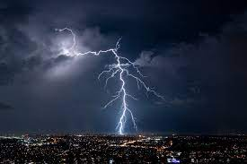
Common emotions after receiving a diagnosis
Terror
Self-blame
Relief
Fears & anxiety
Anger
Shock
Positive
Numbness
Disbelief
Calm
Loss
Denial
Pragmatic
Guilt
Grief
Notes:
Normalise these emotions – very typical to experience these kinds of emotions when you have been given bad news. No need to pathologise – not everyone needs to see a psychologist. But if emotions persist for a while and get in the way of life, it’s helpful to talk to someone (your CNS) about whether some formal psychological support might be helpful

Slide 6
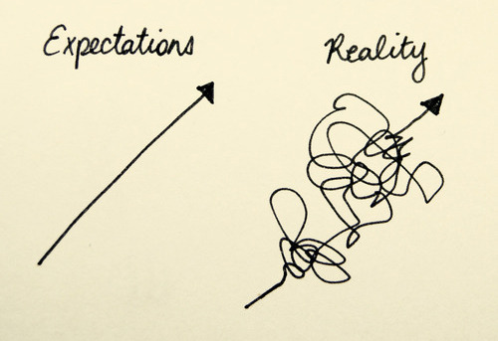
Common emotions during and after treatment
Anxiety / ‘Scanxiety’
Anger
Elated
Despair
Joy
Restless
Relief
Happy
Sad
Fear (of recurrence)
‘Survivors guilt’
Hopeful
Notes:
People sometimes expect the cancer pathway/journey to be linear, but the reality is it often isn’t. Everyone’s experience will be different though.

Slide 7
I felt like I was in this tunnel…I was aware life was going on around me, but I wasn’t part of it
It was actually a relief to find out…to be able to put a name to what was wrong after all this time
Waiting for the results was agonizing…I couldn’t get on with anything I needed to do
I should have known sooner…how did I not know?
My mind went wild…I couldn’t really hear the words the doctor was saying
It was hard to sleep…the middle of the night was the worst
I felt like I was in free-fall for a while
I couldn’t face thinking about the future…I felt robbed
It felt like my horizons were closing in
I had to put on a brave face for my kids over Christmas..I don’t know how I did it
I didn’t know how I was going to tell my family
Notes:
Some quotes from patients about their own emotional reactions and responses.

Slide 8
I felt guilty for not feeling overjoyed when I finished treatment
I don’t feel attractive any more
I couldn’t wait to ring the bell
Waiting for my first scan after treatment was difficult
Finishing treatment felt like falling off a cliff edge
Having my medical team around me makes me feel secure
I
I’m not sure how I’m going to manage going back to work
I was so desperate to get back to normal life
I
I’m struggling to remember who I am
Notes:
More patient quotes

Slide 9
Rollercoaster of emotions
Emotions are not linear – they come and go and some emotions may come back again at different points along the journey
Some feelings aren’t there when you think they ‘should’ be
Anticipating and managing the reactions of family members and friends can be an additional worry
Emotions can be linked to how we feel physically

Slide 10
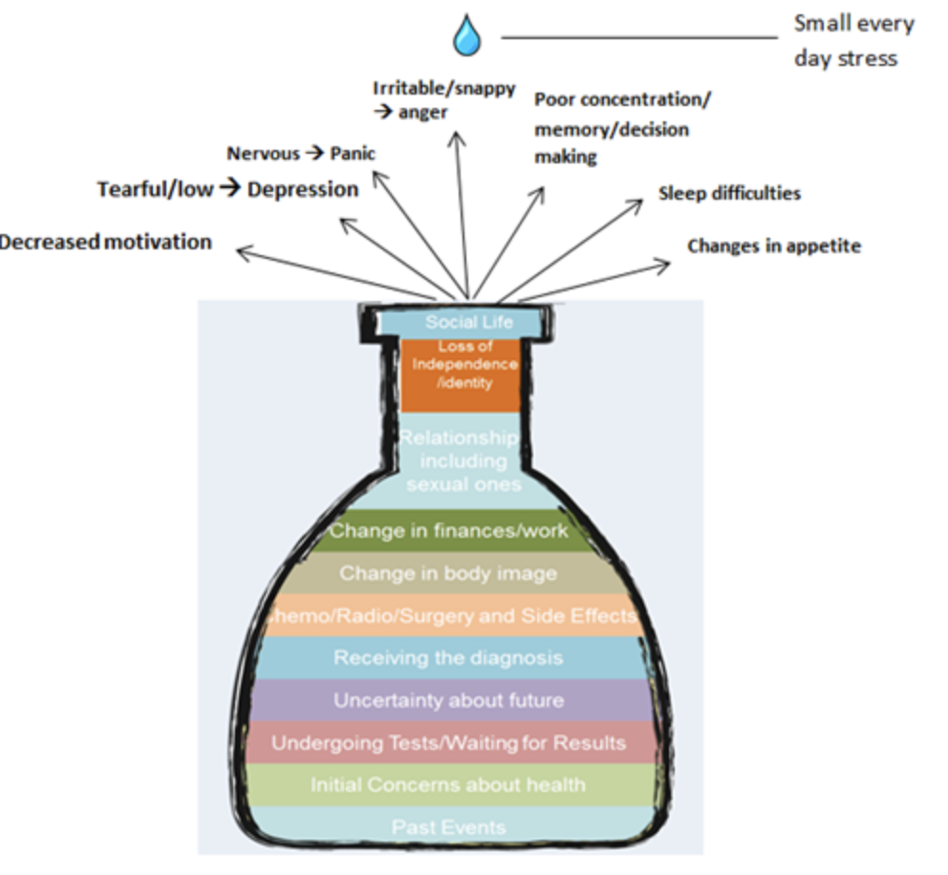
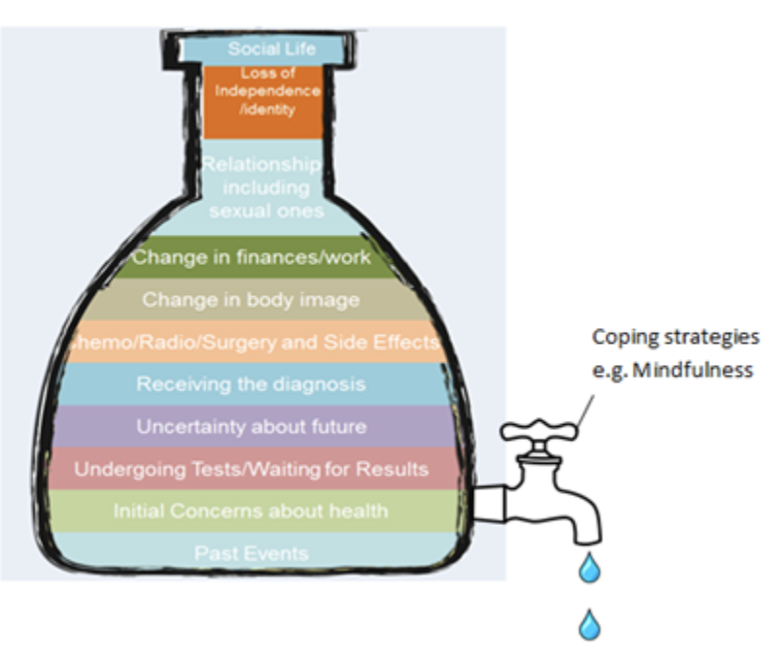
The stress bottle
Acknowledge the stressors in your life before and now-draw your own bottle
Also consider what the people closest to you might have in their bottle
When we have so much going on, one more small thing (not able to find keys/phone) can make us erupt and spill over
What coping strategies have you used in the past that have helped?
Do you need some support to develop new ways of coping?
Notes:
The Stress Bottle is a useful way to help you think about all the stressful things that have happened as well as any changes and loss in your life. It can be useful to think about past stresses and put them at the bottom of the bottle, as well as the stress you have faced in the build-up and after the diagnosis of cancer. Really important to think about coping strategies (taps in the jar that allow some of the water/stress to flow away), otherwise stress will build and build and you may feel you are no longer able to cope. Sometimes we need to develop new ways of coping as things we used previously no longer work. Sometimes people feel that they may need medication to help with significant feelings of depression or anxiety – good idea to speak to GP. Medication can sometimes help us to then be able to use other coping strategies that have a longer lasting effect, such as speaking to friends/exercising etc.
Sometimes, when you sit down and draw out your own stress bottle, you can begin to see that it is not at all surprising you feel stressed! It is also useful to think about what the people you are close to might have in their bottles.
Once the bottle is full, the smallest drop of “every day stress” that tries to squeeze in (e.g., dropping a plate in the kitchen) can lead to a “bottle eruption”. It is at this point that you might well be irritable and snappy, become easily tearful, or feel panicky or low. It is important to remember that the eruption is simply a sign that your bottle is understandably full.
It is unlikely that you will be able to “empty” your bottle completely but you can develop coping strategies that act as a tap to give you space at the top of your bottle so that the “everyday stress” doesn’t tip you into an eruption!

Slide 11
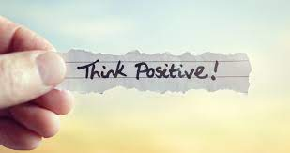
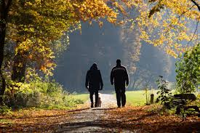
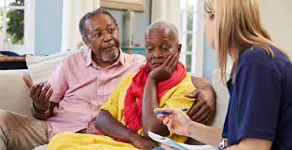
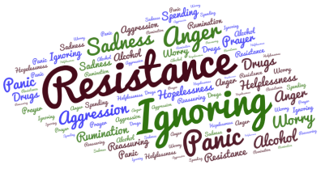
Coping styles
Notes:
Do any of these resonate? Any different ones? What are the pros and cons? Do you feel you may need to develop some different ones?

Slide 12
Coping styles
Many people feel embarrassed and guilty about their emotions – “I shouldn’t be feeling this way”…”I should be strong.” This can increase distress.
People often wear masks and play a character of themselves. This can isolate them from others.
We’re often told to think positively. This can be tricky and doesn’t always feel authentic.
Many people try to ‘block out’ painful thoughts and feelings using a range of approaches. It’s hard to keep this up and emotions and thoughts can feel even stronger when they do break through.

Slide 13
Self-awareness and self-compassion
You are human! Stress, anxiety, worry, anger, sadness…these are all normal, human responses
It’s the context that’s disordered, not you!
Open up to your thoughts and emotions and be kind to yourself
Talk to people about your feelings and worries
Notes:
Becoming more aware of and accepting of our emotional responses is often the first most helpful thing. You have been landed in a difficult context that would be challenging for anyone to navigate. It’s normal and understandable to struggle. Being open about your thoughts and feelings, talking to others and being kind to yourself can help.

Slide 14
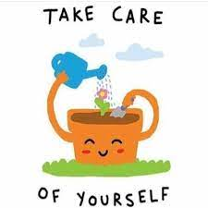
Self-care and compassion
Can you alter the way that you speak to yourself?
How would you speak to your best friend if they were in this situation? What would you say and how would you say it?
Could you notice your thoughts and feelings without judgement?
Is there something small you can do for yourself every day?
Can you pace yourself so that you save some energy for later?
Can you make time to do something just for you?
Notes:
Self-care and compassion are often thought of as selfish – we may think that we don’t have time for such things and that we just need to ‘crack on’ and put on a brave face. But given the emotional and physical toll cancer can take, it’s important to think about how you are going to take small steps to look after yourself.
Whilst we can’t completely do away with our to-do list, perhaps we can re-think or flex personal expectations – good enough is good enough. Perhaps certain things can be delegated or we could prioritise tasks. In between tasks, perhaps there’s the possibility of making time for yourself either to rest or do something that you really enjoy. What small change could you make?

Slide 15
Social support
Social support in some form can have a significant benefit to adjustment and psychological wellbeing
But we know that reaching out doesn’t always feel easy
Who will you tell? How will you respond to questions people ask? How will you keep meaningful relationships going? Who can you share how you are really feeling with?
It can be helpful to set boundaries around conversations so they feel ok for you
Equally, letting people know when you’re happy for them to talk to you about what you are going through
What about when treatment ends/break in treatment…it may be less obvious to people that you still need/want to talk about it…an assumption that ‘it’s over now’…

Slide 16
Thoughts about thoughts!
Ours minds tell us different stories because that’s what minds do….they’re designed to keep us safe…they work on the ’better safe than sorry’ principle
Thoughts are not always facts! They are opinions, stories, narratives
We often think of thoughts as being factual, so they carry a lot of weight and we get ‘hooked’ by them
So our minds might take us straight to the most worrying scenario
The problem is not that we have the thoughts, it’s how we respond to them that can cause the problem
When we get hooked in by our thoughts, we’re likely to let them dictate our mood and our actions
This can be really exhausting and can take us down unhelpful paths and away from the things that matter
Rather than trying to change, block out, or fight our thoughts and emotions, we can focus on how we respond to them. We can learn to change our relationship with them.
Notes:
Intrusive thoughts can just pop into your head any time and take you ‘off track’. They can feel disturbing and overwhelming.
Often worse at night…..one thought can quickly escalate into another….like a train driving you around to lots of places you didn’t want to visit – you don’t feel in control and it can be difficult to get off. We often end up in a wrestle with our thoughts desperately trying to control them or manipulate them, which can make things worse. Helpful to acknowledge that thoughts are just letters strung together to make some words…we don’t need to get hooked in by them and believe all of them.

Slide 17
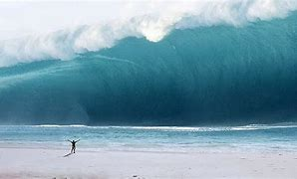
When we try to block out thoughts…..
Notes:
If you tell yourself not to think about something, you are more likely to think about it. (Don’t think about pink elephants, think about anything but pink elephants…..what are you thinking about?!)
When we can no longer block a painful thought out, the thought can hit us like a huge wave and knock us off our feet. Blocking is not a helpful strategy.

Slide 18
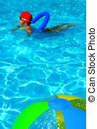
Notes:
Blocking out a thought and getting on with life can be like trying to push a beach ball under the water whilst desperately trying to get on with a swim. It’s impossible to do all the time, uses up a great deal of our energy, prevents us from being able to focus properly, and is bound to pop up and splash you in the face. Instead of pushing the ball down/pushing thoughts away, another option is just to allow the beach ball to be in the pool with you and focus on getting on with your swim. Yes it’s still there and yes it will sometimes bob over towards you, but it will also bob away again and you’ve got a much better chance of being able to swim/do the things you want to do.

Slide 19
Square Breathing
Notes:
Using some techniques to bring us back down when we’re anxious / panicky is the first step to doing something to help ourselves.
But of course, using the breathing or grounding techniques isn’t just helpful when we’re in panic mode – using them before we get to that place can be helpful for obvious reasons.
On top of that, using these techniques at any time (ie, when we’re not approaching panic, when things are going OK for us) has 2 benefits – 1) in reducing overall stress levels, 2) in giving us practice of the techniques so they’re easier to use when we really need them.

Slide 20
Grounding Techniques

Slide 21
Noticing internal states
Noticing your thoughts, feelings, physical sensations
Being an observer
Being curious
Non-judgmental/non critical
“I notice that I’m feeling X”
“I’m having the thought that the cancer might come back”
“I’m aware that I’m feeling worried about the future”
“I’m aware of pressure around my temples”
Notes:
Greater awareness without responding/trying to control/supress. Using the pre-fix helps to put some distance between our thoughts/feelings and us. They are just thoughts and feelings – they do not define us.

Slide 22
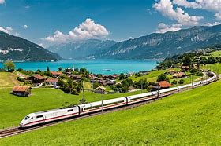
Metaphors
Thoughts as clouds moving across the sky
Thoughts as leaves on a stream
Thoughts as trains leaving the platform
Notes:
Can we visualise our thoughts and feelings as clouds/trains/leaves/….can we watch them/observe them with curiosity and wait for them to pass rather than getting into a struggle with them/trying to block them? Once a storm passes, the sky is still there and unchanged…a bit like us….once our thoughts and feelings that we find distressing pass, we are still there.

Slide 23
Mindfulness of breath exercise
Let's begin by taking a moment to allow your body to settle
Find a comfortable position
You can close your eyes or keep them open with a soft gaze downward a few feet in front of you
Let the belly and shoulders relax
Now take three slow breaths in ….and slowly out….
See if you can bring your attention to your nostrils…and keep breathing slowly in and out
See if you can notice any difference in the temperature of the air around your nostrils as you breath in and out
Notice any thoughts/feelings/sensations that show up for you….acknowledge them and see if you can gently bring your focus back to your nostrils
Keep this going for another 30 seconds or so
Notes:
Try this exercise – see if you notice colder air as you breath in through your nostrils and warmer air as you breath out (or just any other sensations)

Slide 24
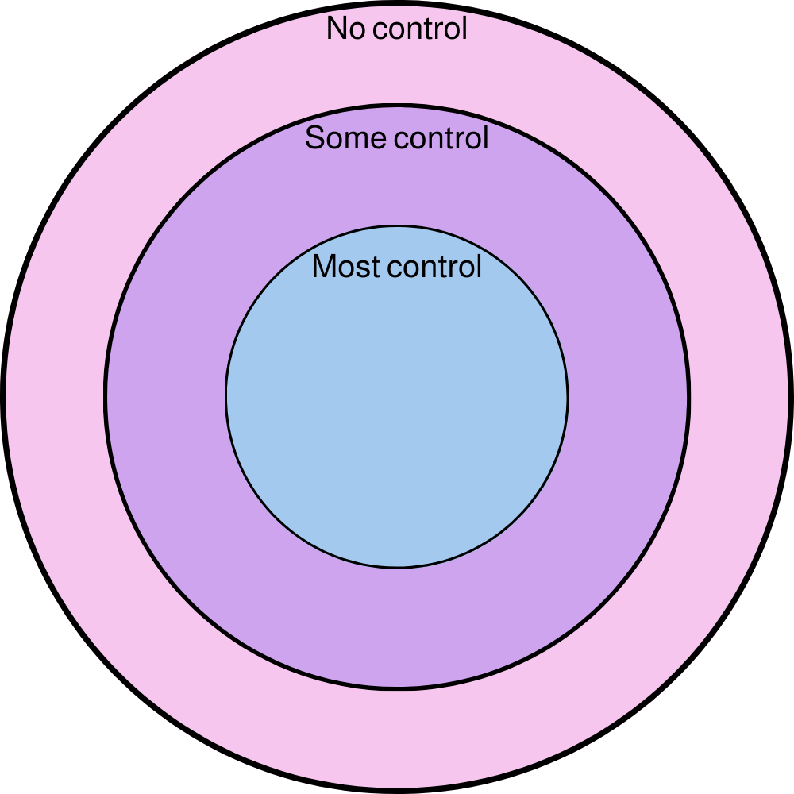
Taking control & letting go
Lots of energy spent on things we can’t control can lead to more distress
Focussing on the things in our life that we can still control or influence – no matter how small – can be helpful
Giving up control of some things can be helpful
Learn to park worries that cannot be solved
Influence
Notes:
Often, we can spend a lot of time and effort thinking about things that are outside our control – when we do this, it can cause a lot of frustration, upset and annoyance as we never feel that we get anywhere or have agency in our own lives. Sometimes people with cancer talk about wanting to know why they got cancer when an answer may never be possible. Cancer can also make us feel like we have no control over our life…lots of things are happening to us that we never asked for or wanted. It can be helpful to think about the things that we do have control over or can influence and letting go of the things that we can’t do anything about.

Slide 25
Taking control and letting go…some examples
‘I’ve always been a planner..I needed to let go of that for a while because making plans then having to cancel them became harder than not making any at all’
‘For a long time I needed to know what had caused my cancer…I obsessed over it. It really got me down more than anything. Once I let go of needing to know, I began to enjoy other things in my life again and focus on them instead’
‘I couldn’t predict when I would have good days and so I started to be more spontaneous and make the most of the times when I felt well’
‘Preparing for my consultant appointment helped me to get the most out of my appointments, so at least I’d always go away having had my questions answered, even though I couldn’t control what the answers would be..’
‘When I was told I had cancer, my whole world felt out of control….I got a lot of comfort from sticking to my usual routine as best I could…I enjoyed the predictability of walking my dog every day, even if I couldn’t walk as far as I used to’
‘I started eating really healthily and walking …it helped me to feel in control’
Notes:
Some examples from patients who have used the circles of control and have focused on things that can do something about, or have shown flexibility in their thinking to enable them to try different ways of doing things.

Slide 26
Worry Tree
Notes:
To let go of the worry, you could try one of the mindfulness exercises – visualising your worry as a cloud passing by or a leaf making its way down stream. You can also visualise the circles of control and try to action something that you can control as a way of brining back to the present.

Slide 27
Notes:
More detailed worry tree.

Slide 28
Notes:
Designated worry time, e.g. after breakfast. Go through list of worries. If worries come up at other times, write them down and save them for worry time.

Slide 29
Dropping the anchor exercise
Dropping Anchor Russ Harris Infographic (leedsth.nhs.uk)

Slide 30
Growing around loss
Grief/Loss
Grief/Loss
Notes:
This view of grief/loss does not tell someone that their grief/loss will go away in time. You may never be ‘over it’. It acknowledges that there will be some days where you feel grief/loss as strongly as you did when you were going through cancer. But there will also be days when you are able to move on with other parts of your life. The ‘growing around grief’ model shows how we can still grieve the loss of our life before cancer while carrying on with our lives. It shows that we can grow a new life which includes the loss.

Slide 31
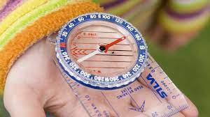
Values
What matters most to you?
What would living well look like?
What would you be doing?
What would others notice?
What are the things that are getting in your way of doing the things that matter?
How might you adapt how you do things?
Notes:
One thing that can help us to live alongside cancer, is through being clear about our values – what matters most to us. This could be personality traits, or ways of being, e.g. compassionate, honest, hard working, caring for others, integrity, creativity, excitement, adventure, humour, fitness. They are different to goals as they do not have an end point – they are not something that we just accomplish. Values help us to make choices based on what matters to us – we think of values as being like a compass that can guide us to think about what now and what next, one step at a time. It is also completely ok to do nothing right now…you may well just need time to rest and recover, so try to let go of feelings that you must know what to do now right away.

Slide 32
Where to go for further support
The Macmillan Hub based at GRH (including for financial advice)
Maggie’s: www.maggiescentres.org (Cheltenham)
Charlies www.charlies.org.uk (Gloucester)
Longfield Hospice www.longfields.org.uk (Minchinhampton)
Great Oaks Hospice www.great-oaks.org.uk (Coleford)
Free BUPA counselling sessions available through Macmillan www.macmillan.org.uk
Chaplaincy (for spiritual needs)
Voluntary Support Groups (for informal or practical support)
Listening Post; Gloucestershire Counselling Service for non-cancer work
Trekstock, Shine for younger patients
Speak to your CNS if you think a referral to the cancer and palliative care psychology service might be helpful

Slide 33
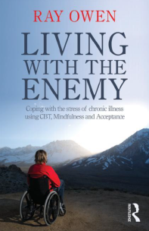
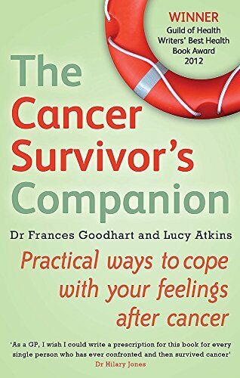
Resources
Notes:
Any other book recs?

Slide 34
Resources
www.actmindfully.com.au/free-stuff/free-audio/ (dropping the anchor and mindfulness audios-lots!)
Box Breathing - Reduce Anxiety - Navy SEAL Method | Hands-On Meditation - Bing video (square breathing exercise)
https://www.sfh-tr.nhs.uk/our-services/clinical-psychology-cancer-service/ (excellent resources for coping emotionally)

Slide 35
Further Resources
Managing Fatigue - https://www.youtube.com/watch?v=T7albItnizw&feature=youtu.be
Exercise - https://www.youtube.com/watch?v=FjaNjTvZv08&feature=youtu.be
Sleep - https://www.youtube.com/watch?v=ML_NL8EdhCc&feature=youtu.be
Psychological wellbeing - https://www.youtube.com/watch?v=I7dOVKy2ajQ&feature=youtu.be
Nutrition - https://www.youtube.com/watch?v=nK43C39Yc7M&feature=youtu.be​

